Slide 1
Package Diagram
UML (Unified Modeling language)

Slide 2
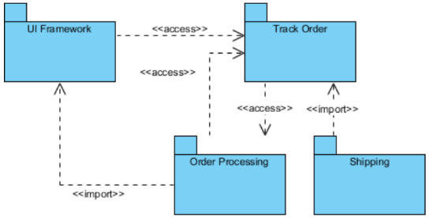
How Package Diagram Looks Like?

Slide 3
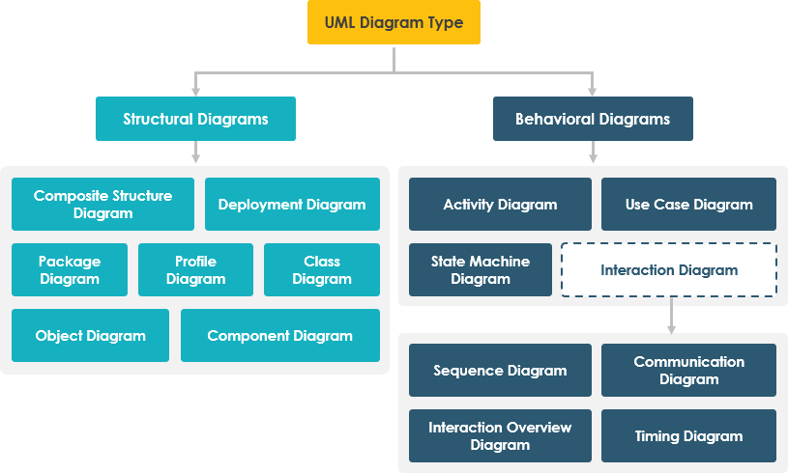
Package Diagram

Slide 4
What is Package Diagram?
Package diagrams are UML structural diagrams.
Use case package diagram, class package diagram etc.
Package diagram shows the arrangement and organization of model elements in middle to large scale project.

Slide 5
What is Package Diagram?
They are used to show the organization and arrangement of various model elements in the form of packages.
Such as diagrams, documents, classes, or even other packages.

Slide 6
Benefits of Package Diagram
A well-designed package diagram provides numerous benefits to those looking to create a visualization of their UML system or project.
They provide a clear view of the hierarchical structure of the various UML elements within a given system.
These diagrams can simplify complex class diagrams into well-ordered visuals.

Slide 7
Benefits of Package Diagram
They offer valuable high-level visibility into large-scale projects and systems.
Package diagrams can be used to visually clarify a wide variety of projects and systems.
These visuals can be easily updated as systems and projects evolve.

Slide 8
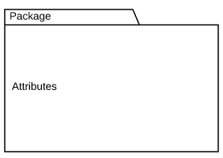
Package Diagram Basic Symbols
Symbol Name: Package
Description: Groups common elements based on data, behavior, or user interaction

Slide 9

Package Diagram Basic Symbols
Symbol Name: Dependency
Description: Depicts the relationship between one element (package, named element, etc.) and another

Slide 10
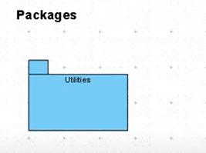
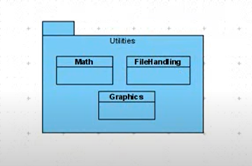
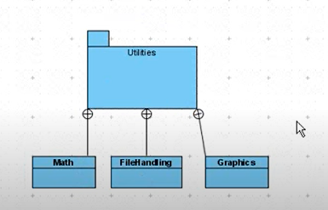
Packages and Containment in Package

Slide 11
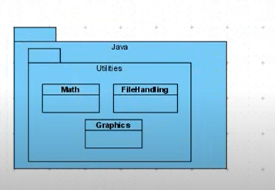
Nested Package

Slide 12
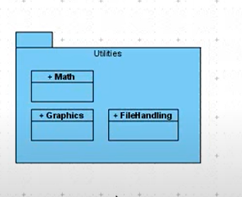
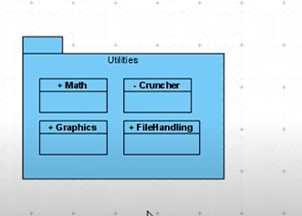
Visibility

Slide 13
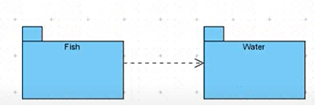
Dependency

Slide 14
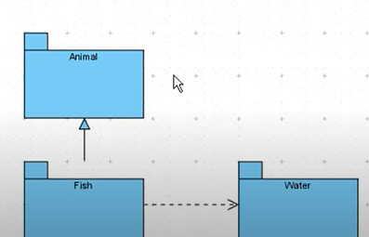
Generalization

Slide 15
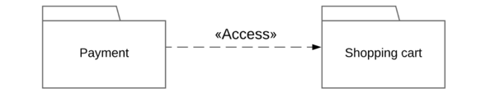
Package Diagram Basic Symbols
Symbol Name: Dependency
There are two main types of dependencies:
Access: Indicates that one package requires assistance from the functions of another package. Example:

Slide 16
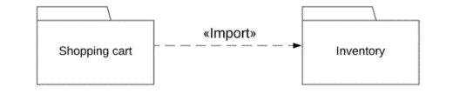
Package Diagram Basic Symbols
Symbol Name: Dependency
There are two main types of dependencies:
Import: Indicates that functionality has been imported from one package to another. Example:

Slide 17
Book and Library Package in Code
// Book.java
package library;
public class Book {
private String title;
private String author;}
// Library.java
package library;
public class Library
{ private String name;
private List<Book> books}

Slide 18
Import Package
// Library.java
package library;
import java.util.List;
public class Library
{ private String name;
private List<Book> books;
}

Slide 19
Example 1: Order Processing System
How to Draw Package diagram

Slide 20

Example 1: Order Processing System

Slide 21
Example 1: Order Processing System
Step 1: Identify the packages
UI Framework: is the set of classes and interfaces.
Track Order: it has to talk with other module to know about the order details.
Order Processing: picking, packing, and delivery of the packed items.
Shipping: to know shipping information, "Shipping" can import "Track Order”.

Slide 22
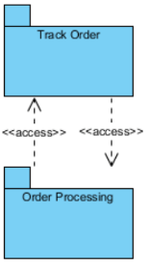
Example 1: Order Processing System
Step 2: Identify the dependencies in the System
Track order should get order details from "Order Details" and "Order Details" has to know the tracking info given by the customer.
Two modules are accessing each other which suffices <<access>> dual dependency.

Slide 23
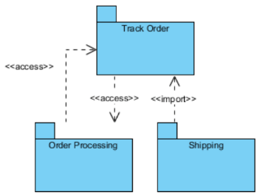
Example 1: Order Processing System
Step 2: Identify the dependencies in the System
To know shipping information, "Shipping" can import "Track Order" to make the navigation easier.

Slide 24
Example 1: Order Processing System
Step 2: Identify the dependencies in the System
Finally, Track Order dependency to UI Framework is also mapped which completes our Package Diagram for Order Processing subsystem.

Slide 25
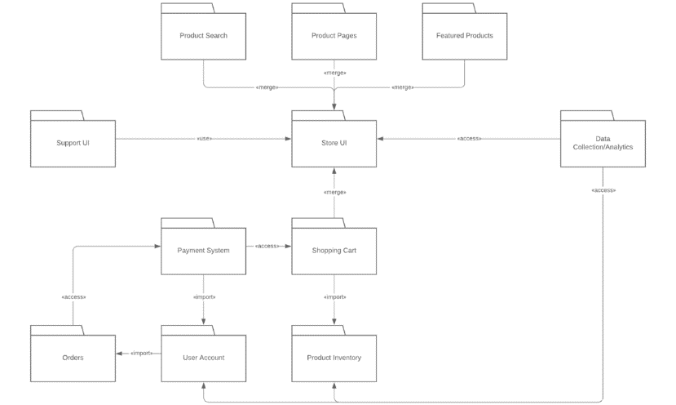
Example 2: Online Shopping

Slide 26
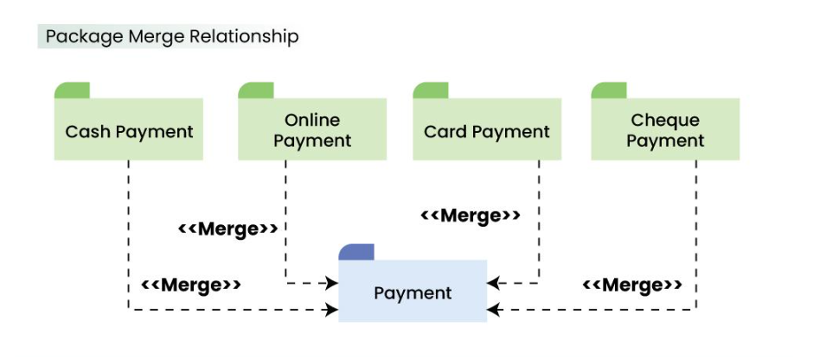
Package Relationships-Merge
This relationship is used to represent that the contents of a package can be merged with the contents of another package. This implies that the source and the target package has some elements common in them, so that they can be merged together.

Slide 27
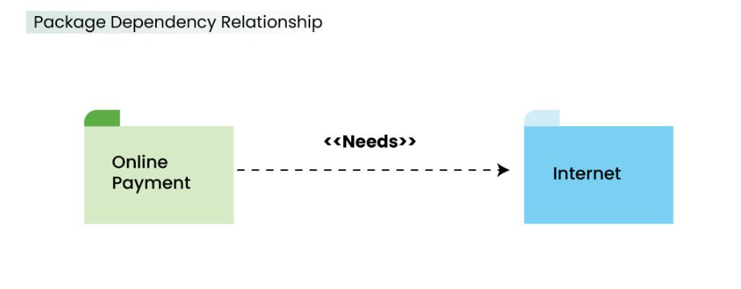
Package Relation –Dependancy Relation
A package can be dependant on other different packages, signifying that the source package is somehow dependent on the target package.

Slide 28
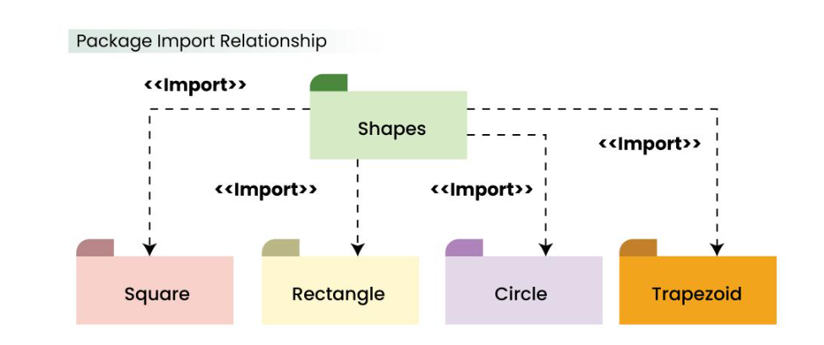
Package Relation-Import
This relationship is used to represent that a package is importing another package to use. It signifies that the importing package can access the public contents of the imported package.

Slide 29
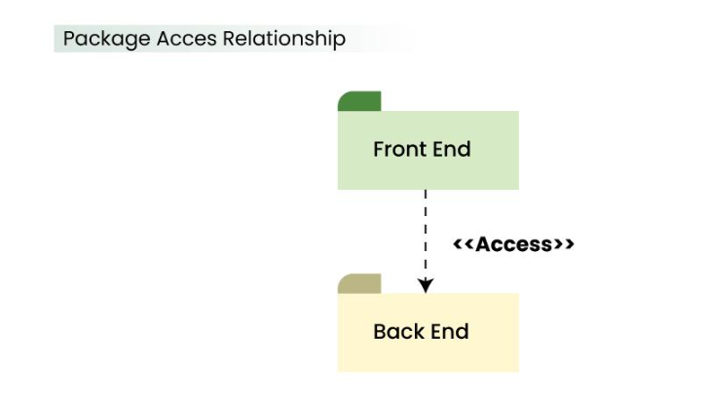
Package Relation -Access
This type of relationship signifies that there is a access relationship between two or more packages, meaning that one package can access the contents of another package without importing it.

Slide 30
Timing Diagram
UML (Unified Modeling language)

Slide 31
Timing Diagram

Slide 32
What is Timing Diagram?
A timing diagram is a specific UML behavioral modeling diagram that focuses on timing constraints.
It show’s how objects interact with each other during a certain period of time.
In a timing diagram, time passes on the x-axis from left to right, with different components of the system that interact with each other on the y-axis.

Slide 33
What is Timing Diagram?
Timing diagrams show how long each step of a process takes.
We use timing diagram to identify which steps of a process require too much time and to find areas for improvement.

Slide 34
Benefits of Timing Diagram
One of the key benefits of a UML timing diagram is that it gives users an overview of what goes on in a system or piece of software.
More critically, it shows which steps in a system take too much time, and this information can be used by business users and developers alike to improve their processes.
With timing diagrams, we can easily diagram a process and identify the major steps it takes to complete the process.

Slide 35

Timing Diagram Basic Symbols
Symbol Name: Lifeline
Description: A lifeline in a Timing diagram forms a rectangular space within the content area of a frame. Lifeline is a named element which represents an individual participant in the interaction. It is typically aligned horizontally to read from left to right.

Slide 36
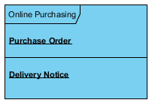
Timing Diagram Basic Symbols
Multiple lifelines may be stacked within the same frame to model the interaction between them.

Slide 37
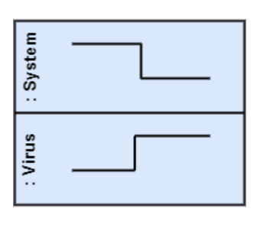
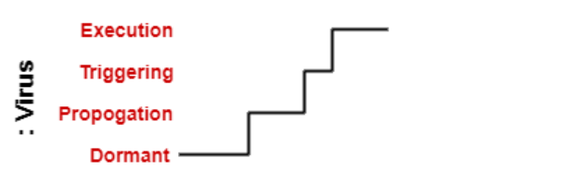
State or Condition Timeline
The timing diagram represents the state of a classifier or attributes that are participating, or some testable conditions, which is a discrete value of the classifier.
In UML, the state or condition is continuous. It is mainly used to show the temperature and density where the entities endure a continuous state change.

Slide 38
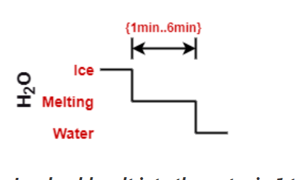
Duration Constraint
The duration constraint is a constraint of an interval, which refers to duration interval. It is used to determine if the constraint is satisfied for a duration or not. The duration constraint semantics inherits from the constraints.
Ice should melt into the water in 1 to 6 mins.

Slide 39
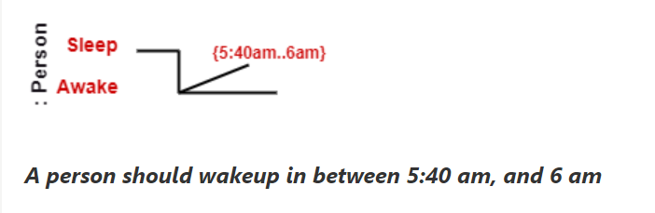
Time constraint
It is an interval constraint, which refers to the time interval. Since it is a time expression, it depicts if the constraint is satisfied or not.

Slide 40
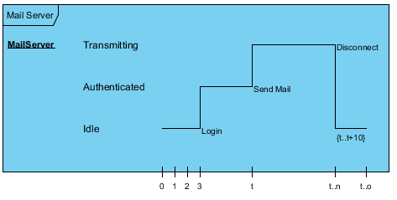
Timing Diagram Basic Symbols
Operation/System Name
States
Duration
Lifeline
Stimuli
Time Unit
Notes:
Stimuli= a thing or event that evokes a specific functional reaction

Slide 41
Example
A timing diagram example of a medical domain that depicts different stages of Alzheimer's disease (AD) is explained below.
Since Alzheimer's is a very progressive fatal brain disease, it leads to memory loss and intellectual abilities. The reason behind this disease is yet to be discovered. It cannot be cured as well as one of the main reasons for rising death rates in the United States.
The doctor may require a diagnostic framework with three to seven-stage, such that its evolution may last for about 8 to 10 years. Also, in some cases, it lasts up to 20years from the time neuron starts changing.

Slide 42
Stages of Alzheimer Disease
No Impairment, Normal State It is the stage where the memory and cognitive abilities look normal.
Normal Aged Forgetfulness It is mostly seen in people with an age group of 65 who experience subjective complaints of cognitive and/or functional difficulties, which means they face problems in recalling the name and past 5 to 10 years of history.
Early Confusional, Mild Cognitive Impairment It causes a problem in retrieving words, planning, organizing, objects misplacing as well as forgetting fresh learning, which in turn affects the surrounding.
Late Confusional, Mild Alzheimer's In this, a person forgets the most recent events and conversations. The person remembers himself and his family, but face problems while carrying out sequential tasks such as cooking, driving, etc. Its duration is about two years,

Slide 43
Stages of Alzheimer Disease
Early Dementia, Moderate Alzheimer's In this, the person cannot manage independently. He faces difficulty in recalling the past details and contact information. It lasts for about 1.5 years.
Middle Dementia, Moderately Severe Alzheimer's It leads to insufficient awareness about current events, and the person is unable to recall the past. It causes an inability in people to take a bath and dress up independently. It lasts for about 2.5 years approximately.
Late or Severe Dementia, Failure to Thrive It is severely limited intellectual ability. In this, a person either communicates through short words or cries, which leads health to decline as it shut down the body system. Its duration is 1 to 2.5 years.

Slide 44
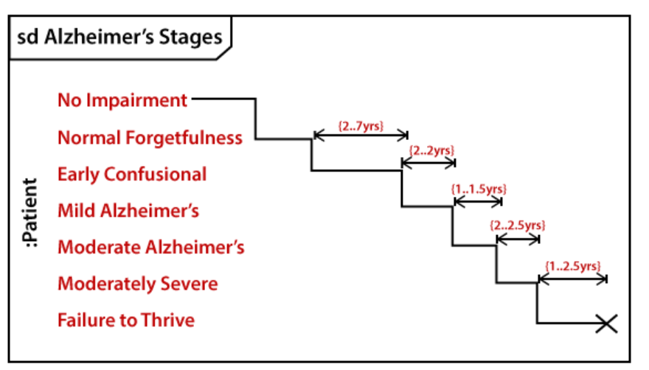

Slide 45
Example : Order Processing System
How to Draw timing diagram

Slide 46
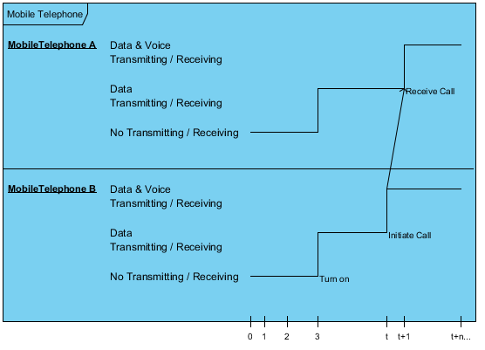
Example

Slide 47
Example :User Request to Web Server
How to Draw timing diagram

Slide 48
